Slide 1

Kansas cancer partnership
February 11, 2020

Slide 2

Welcome
Josh Mammen, MD, PhD, FACS
Notes:
Notes to presenter:
What is your purpose for sharing this reflection?
Is it at the end of a unit or project?
Are you sharing this reflection, at the attainment of a learning goal you set for yourself?
Is it at the end of a course?
State your purpose for the reflection or even the purpose of the learning experience or learning goal. Be clear and be specific in stating your purpose.

Slide 3

National Perspectives on Cancer Prevention and Control
Lisa A. Richardson, MD, MPH
Notes:
Notes to presenter:
Description of what you learned in your own words on one side.
Include information about the topic
Details about the topic will also be helpful here.
Tell the story of your learning experience. Just like a story there should always be a beginning, middle and an end.
On the other side, you can add a graphic that provides evidence of what you learned.
Feel free to use more than one slide to reflect upon your process. It also helps to add some video of your process.

Slide 4
Break/visit exhibits
Notes:
Notes to presenter:
What is your purpose for sharing this reflection?
Is it at the end of a unit or project?
Are you sharing this reflection, at the attainment of a learning goal you set for yourself?
Is it at the end of a course?
State your purpose for the reflection or even the purpose of the learning experience or learning goal. Be clear and be specific in stating your purpose.

Slide 5
The Health of Kansans, With a Focus on Cancer
Lee A. Norman, MD
Notes:
Notes to presenter:
Description of what you learned in your own words on one side.
Include information about the topic
Details about the topic will also be helpful here.
Tell the story of your learning experience. Just like a story there should always be a beginning, middle and an end.
On the other side, you can add a graphic that provides evidence of what you learned.
Feel free to use more than one slide to reflect upon your process. It also helps to add some video of your process.

Slide 6


The Health of Kansans: a Focus on Cancer
Lee A. Norman, MD, MHS, MBA
Secretary, Kansas Department of Health and Environment | February 11, 2020
State Health Officer of Kansas

Slide 7

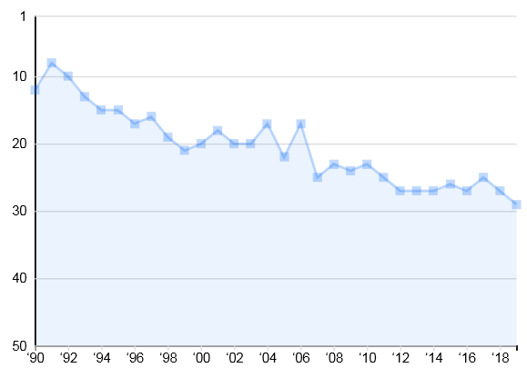
Of all the states in the US, over the past 30 years, Kansas has seen the greatest decline in its health rankings.
Kansas Health Ranking
1990-2019
“
Rank
(America’s Health Rankings, December 6, 2019)
Edition Year

Slide 8


Every day in Kansas
99 Live Births
76 Deaths
36 Births to unwed mothers
6 Live births to teenagers
7 Low birthweight live births
<1 Infant death
16 Heart Disease
15 Cancer
5 Chronic lower respiratory disease
4 Unintentional injuries
3 Cerebrovascular Disease
2 Alzheimer’s Disease
2 Diabetes
2 Pneumonia & Influenza
2 Suicide
1 Nephritis, nephrotic syndrome, nephrosis

Slide 9

Health
Beyond traditional “public health,” and not a specific agency or department
Opportunities to be healthy
Requires active processes
To change the trajectory we must think differently
May challenge our long-held beliefs in order to improve
Beyond just “medical care”

Slide 10
Public Health
Public Health – Informed Plan Design
Kansas Health and Environment Lab
Manpower, Recruit/Retain Staff
Health Care Finance
Environment

Slide 11

America’s Health Rankings
United Health Foundation and the American Public Health Association (APHA)
30 years of data measurement
30+ sources (CDC, US Dept of Education, US Census Bureau, US EPA, US DOLS, US DOJ and FBI, US HHS/CMS, ADA, Dartmouth Atlas of Health Care)
Data through CY 2018

Slide 12





Health ranking domains
Behaviors
(23rd in US, -0.008)
Community & Environment
(25th in US, 0.058)
Policies that Drive Health
(39th in US, -0.043)
Clinical Care
(34th in US, -0.042)
Outcomes
(26th in US, 0.013)
Below average
Average
Below average
Below average
Average
**Overall, Kansas ranks 29th in the US (-0.221)**

Slide 13

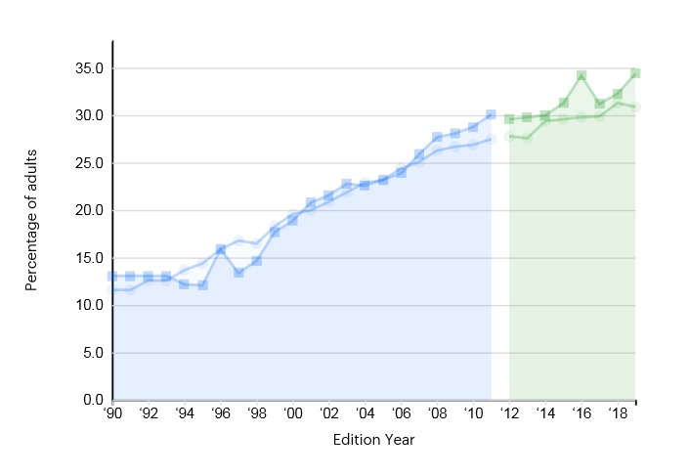
Behaviors
Below average (23rd in US, -0.008)
Low drug deaths (#6 in US), 11.6/100,000
Obesity (#38 in US)
Smoking (#30 in US), 17.2% of adults – was 23% in 1990, but no change in the past 15 years, and worsening because of vaping/e-cigarettes

Slide 14
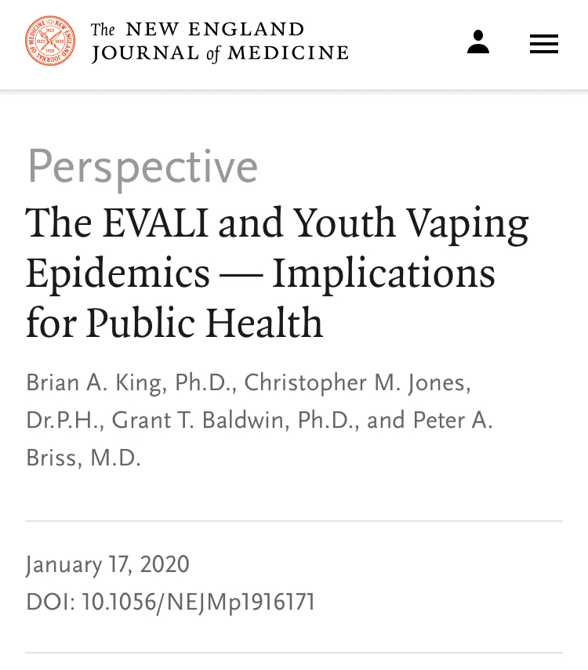
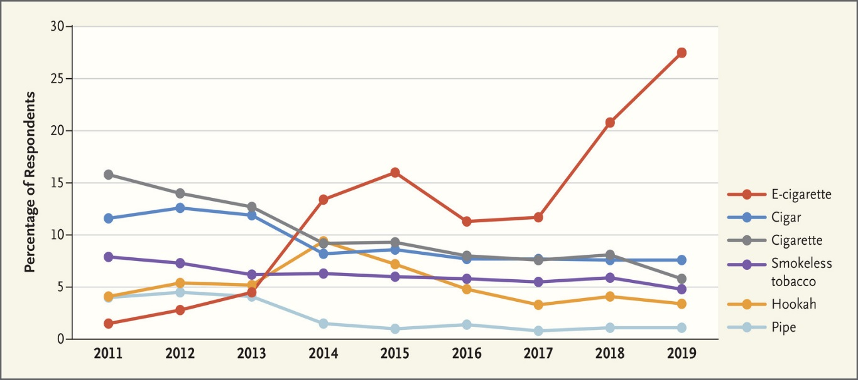
The vaping epidemic: U.S. and Kansas

Slide 15

Community & Environment
Average (25th in US, 0.058)
Chlamydia 2X the healthiest ranked state
  Kansas at 465/100,000
Pertussis 10X the highest-ranked state (0.7 vs 7.0 per 100,000)
Violent crime (#36 in US), 439 offenses/100,000
Occupational fatalities 2X US average, (#32 in US)
Air quality (#18)
Number of children in poverty (#21 in US) with 15% of children living in poverty

Slide 16
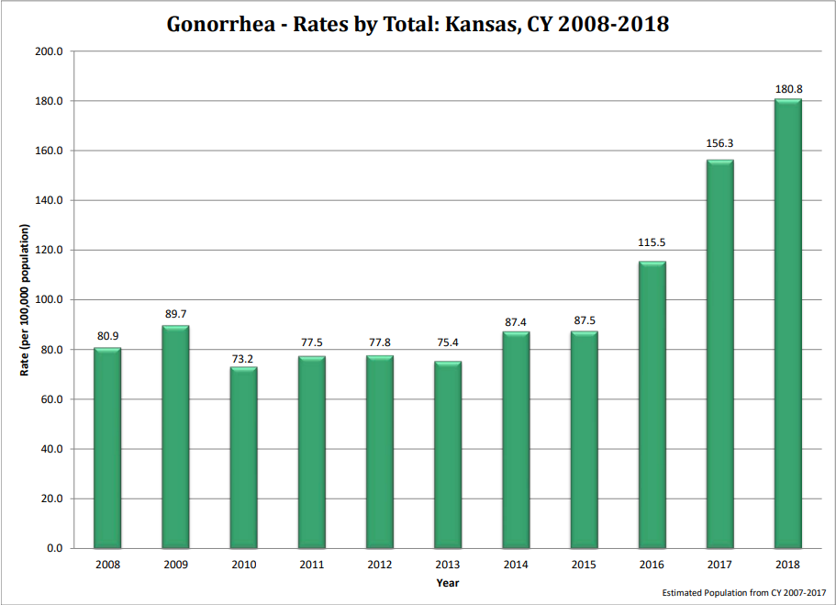
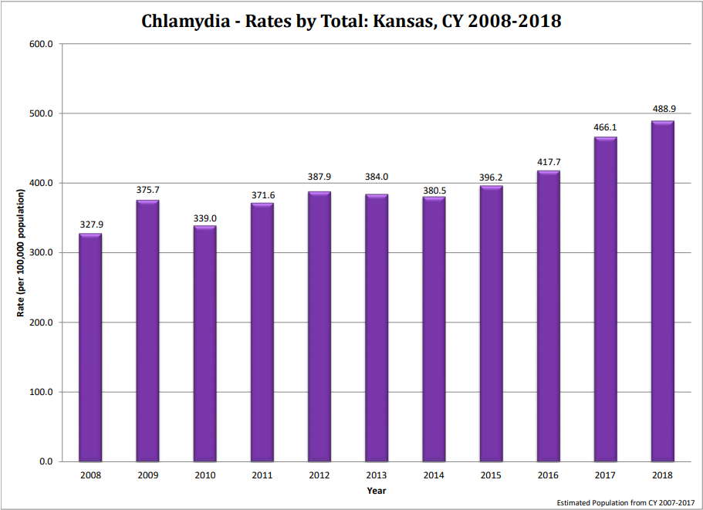
Gonorrhea and Chlamydia

Slide 17
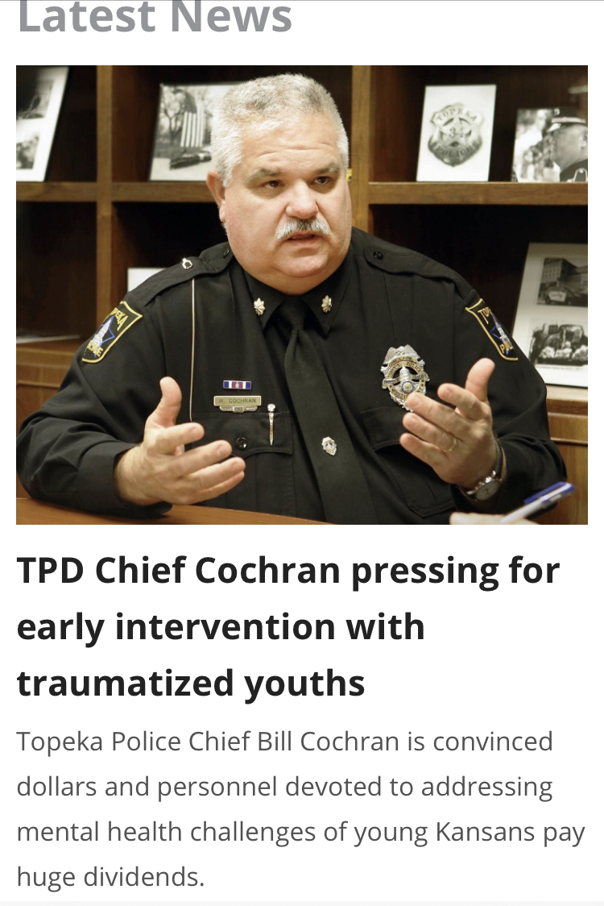
Violent Crime and its Aftermath

Slide 18

Policy
Below average (39th in US, -0.043)
Immunizations
  HPV females (#49 in US); HPV males (#34 in US)
  Meningococcal (#46 in US)
  Children 19-35 months (#32 in US) with 69% completion rate for age
Funding
  Public health funding (#40 in US, Kansas at $60/person), 4.5X less than top state at $281/person
Uninsured % of population (#31 in US, 3X higher than top state)

Slide 19
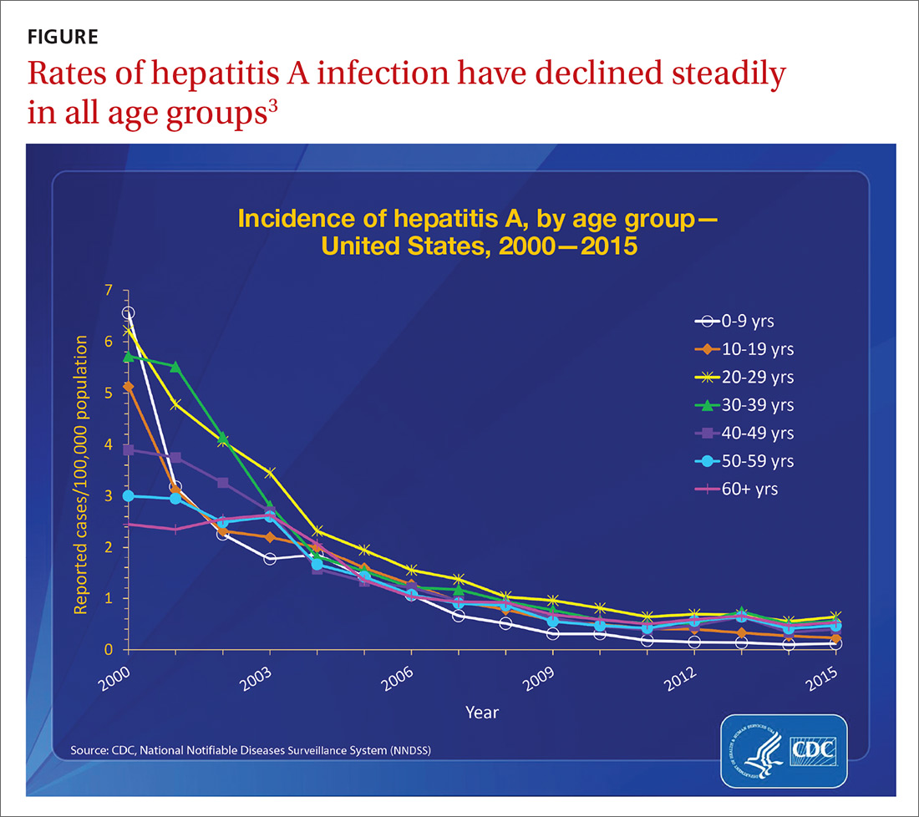
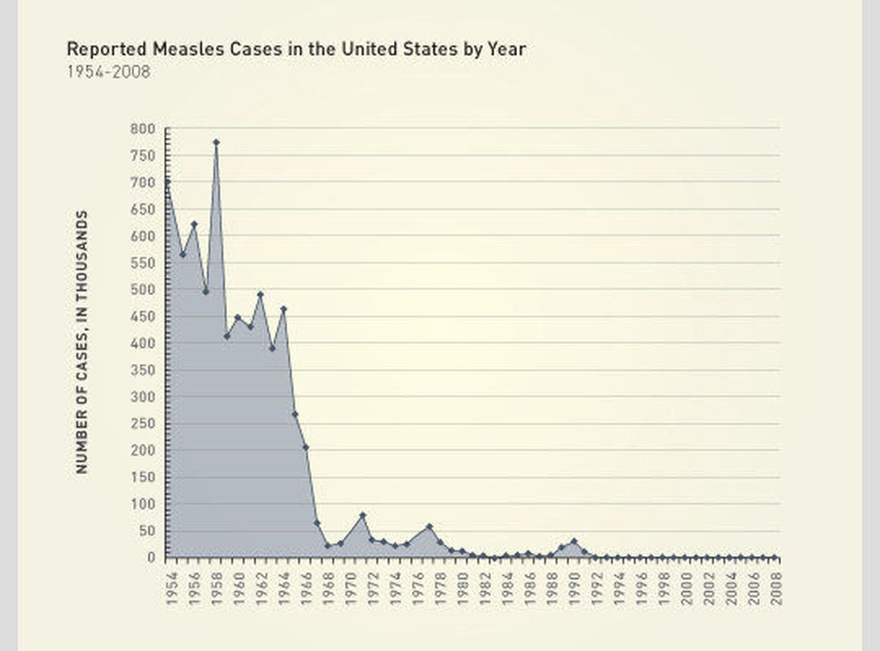
Reminder: immunizations are effective and safe

Slide 20
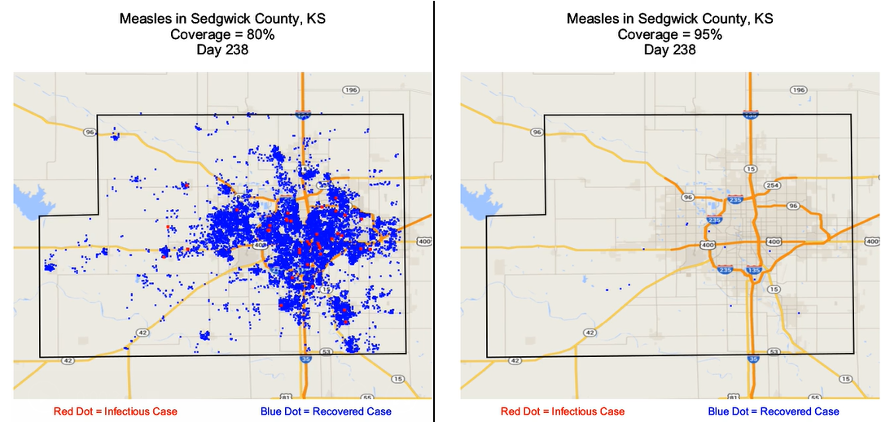
Measles Sedgwick County (simulation)

Slide 21

Clinical Care
Below average (34th in US, -0.042)
Access to dentists (#38 in US), 50/100,000 vs 83 for top state
Low birthweight newborns (#14 in US at 7.4%)
Mental health providers (#35 in US), 196/100,000 vs 627/100,000 for top state
Preventable hospitalizations (#32 in US), 2X the US average
Primary care physicians (#32 in US),138/100,000 vs 275/100,000 in top state)

Slide 22
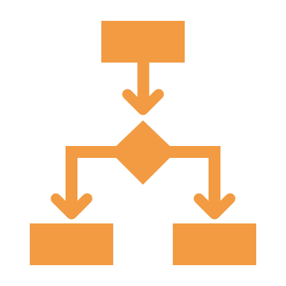
Outcomes
Average (26th in US, 0.013)
Cancer, cardiovascular, and diabetes deaths: bottom ½ of US
Frequent mental distress: bottom ½ of US
Infant mortality: bottom ½ of US
Premature deaths in years lost before age 75: bottom ½ of US

Slide 23




2020
Kansas Diabetes Report
A Report to the Kansas Legislative Coordinating
Council in Accordance with House Bill 2219

Slide 24
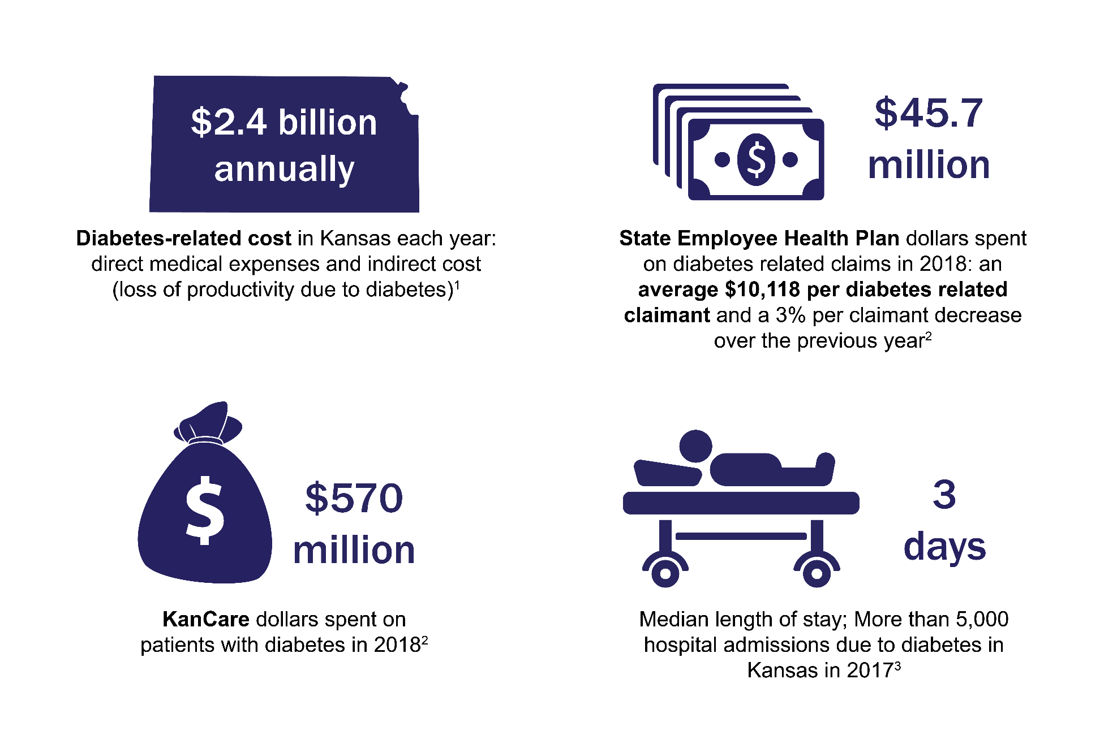
Diabetes: Costly

Slide 25
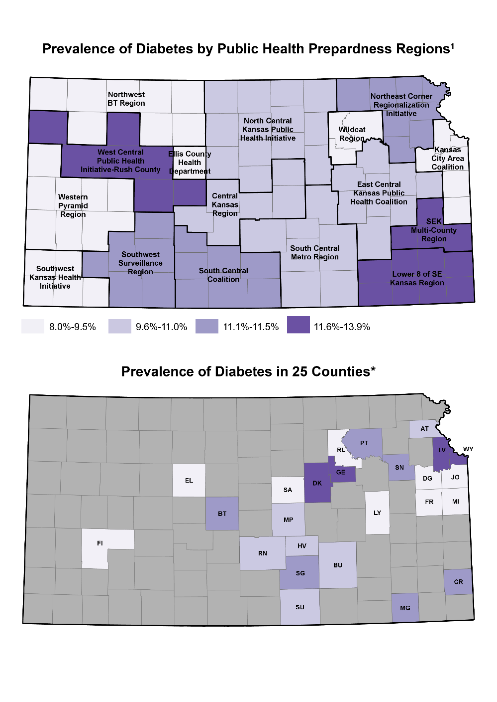
Diabetes: Common
County | Prevalence (%)
Wyandotte (WY) | 14.1
Dickinson (DK) | 12.9
Geary (GE) | 12.7
Leavenworth (LV) | 11.8
Sedgwick (SG) | 11.5
Shawnee (SN) | 11.5
Barton (BT) | 11.5
Montgomery (MG) | 11.5
Crawford (CR) | 11.4
Pottawatomie (PT) | 11.3
Harvey (HV) | 10.4
Butler (BU) | 9.9
Reno (RN) | 9.8
McPherson (MP) | 9.8
Atchison (AT) | 9.6
Sumner (SU) | 9.6
Saline (SA) | 9.5
Ellis (EL) | 9.3
Miami (MI) | 8.9
Franklin (FR) | 8.8
Johnson (JO) | 7.8
Finney (FI) | 7.8
Douglas (DG) | 7.6
Lyon (LY) | 7.1
Riley (RL) | 5.5

Slide 26
What does the data suggest?
Access to care
  Health manpower shortages
  Geographic disparity in health outcomes, especially trauma
  Financial impediments / cost of care
  Transportation shortcomings
  Significant regional, cultural, and ethnic variability
  Obstacles to care exist for mental health and substance abuse disorder patients
Behaviors need to change: nutrition, physical activity, drug/tobacco, seat belts
Community variability in access to clean air and water and public safety
Focus on illness prevention and early intervention, especially sexually-transmitted illnesses (STIs), needle-transmitted diseases, and immunization-preventable ones
Poverty drives of poorer health

Slide 27

A word about Medicaid expansion
Top 18 states have all expanded Medicaid
The states with the greatest increases in their rankings have all expanded Medicaid
The states with the greatest decreases in their rankings have not

Slide 28
Additional concerns
Congenital syphilis
HIV and Hepatitis C
  Undiagnosed Hepatitis C
Trauma program was de-funded in the past
Pervasive anti-vaccine ideologies
Direct-caregiver manpower shortages, especially child care and home/community-based services
Concern about death certificate data accuracy / under-reporting
  Suicides
  Drug overdoses and death

Slide 29
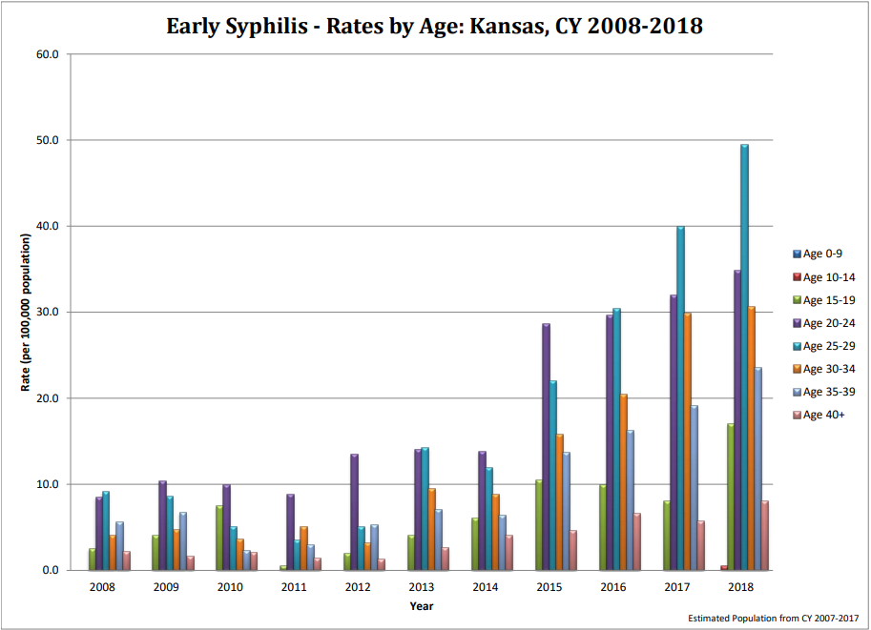
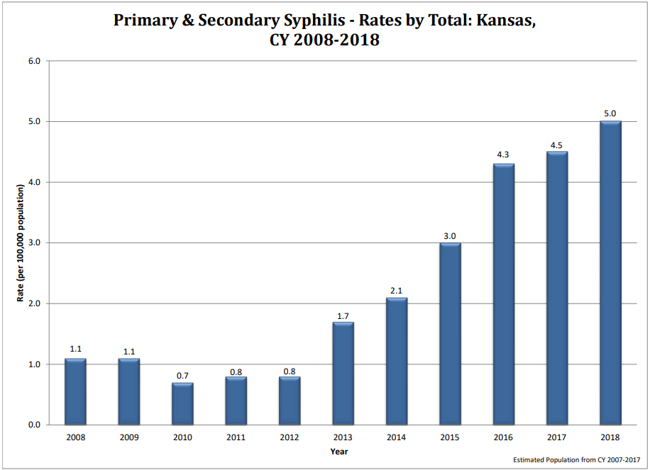
Syphilis: early and late-stage

Slide 30
HIV
Calendar Year | Prevalent HIV Cases | Incident HIV Cases | Prevalent Stage 3 Cases | Incident Stage 3 Cases | Total New HIV and Stage 3 Cases | Total KS Residents Living with HIV or Stage 3
2014 | 1319 | 97 | 1580 | 69 | 166 | 2899
2015 | 1432 | 107 | 1643 | 63 | 170 | 3075
2016 | 1518 | 151 | 1639 | 54 | 205 | 3157
2017 | 1506 | 96 | 1556 | 59 | 155 | 3062
2018 | 1476 | 157 | 1571 | 66 | 223 | 3047

Slide 31
What makes us uncomfortable (and what to do about it)?
Sexually-transmitted illnesses (STI) are increasing
Sexual health education and discussions about contraception and family planning
Dealing with illicit needle-transmitted diseases and what to do about them
The tendency to “blame” trends on certain populations of people
Willingness to make ideological concessions in order to improve health
Spending more money on health
Questioning whether our current approach to health are working
  Scope of practice
  Prescribing laws and expansion of provider “types”
  Considering the “greater good” rather than just what serves each of us best

Slide 32
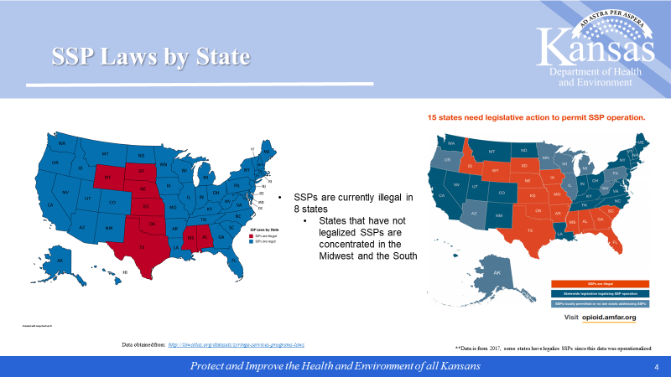
Safe syringe programs (SSPs): an example of how some states have tackled needle-transmitted diseases

Slide 33
What’s Next
Learn more about the health of Kansans
  Today is but a start
Commit to reversing our 30 year backslide
Be receptive to different thoughts and approaches
  SSPs, expedited partner therapy, and HIV Pre-Exposure Prophylaxis (PrEP)
  Long-acting reversible contraception (LARC) for those requesting it
  Obesity and diabetes reduction
Expand existing programs that are known to work - trauma, infectious disease investigation services, adult health/child/family health education
Develop a locally-customized health care delivery model
Embrace assisting technology, such as telemedicine
Support and expand tobacco and vaping prevention/cessation efforts
Align agendas: legislative, agency, association, advocacy group and local health departments

Slide 34
Opportunities for improvement: Agency legislative initiatives in 2020
Innovative public health practices
Modernize current regulations and licensing procedures
Support and funding for existing programs

Slide 35

Looking at Kansas through rose-colored glasses is not a success strategy
Public Health
Public Health – Informed Plan Design
Kansas Health and
Environment Lab
Manpower, Recruit/
Retain Staff
Health Care
Finance
Environment

Slide 36

Thank you/Questions
2020: The State of the Health of Kansans

Slide 37
lunch/visit exhibits
Notes:
Notes to presenter:
What is your purpose for sharing this reflection?
Is it at the end of a unit or project?
Are you sharing this reflection, at the attainment of a learning goal you set for yourself?
Is it at the end of a course?
State your purpose for the reflection or even the purpose of the learning experience or learning goal. Be clear and be specific in stating your purpose.

Slide 38


KCP History and Next Steps
Beginnings
4
Accomplishments
3
2
Gaps
1
Next Steps & Required Resources
Notes:
KCP is a network of cancer prevention and control stakeholders whose goal and purpose is to enact an integrated approach to reducing cancer incidence, morbidity and mortality through prevention, early detection, survivorship and quality of life.

Slide 39
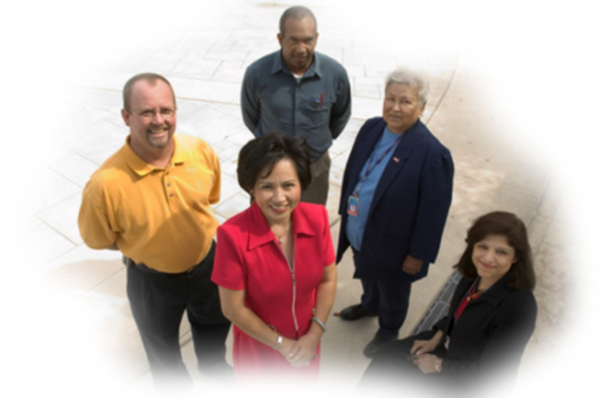
Beginnings
Notes:
Notes to presenter:
KCP began in 1999 with about 20 individuals
Support came from Centers for Disease Control and Prevention to develop a state plan for cancer control. CDC provides this support to U.S. states, tribes and territories for the purposes of convening cancer stakeholders and instigating actions for prevention, screening and treatment. Dr. Gary Doolittle and Peggy Johnson were the first Chair and Co-Chair. Peggy is with us today. Dr. Doolittle is still involved and he co-chairs the Health Equity workgroup.

Slide 40

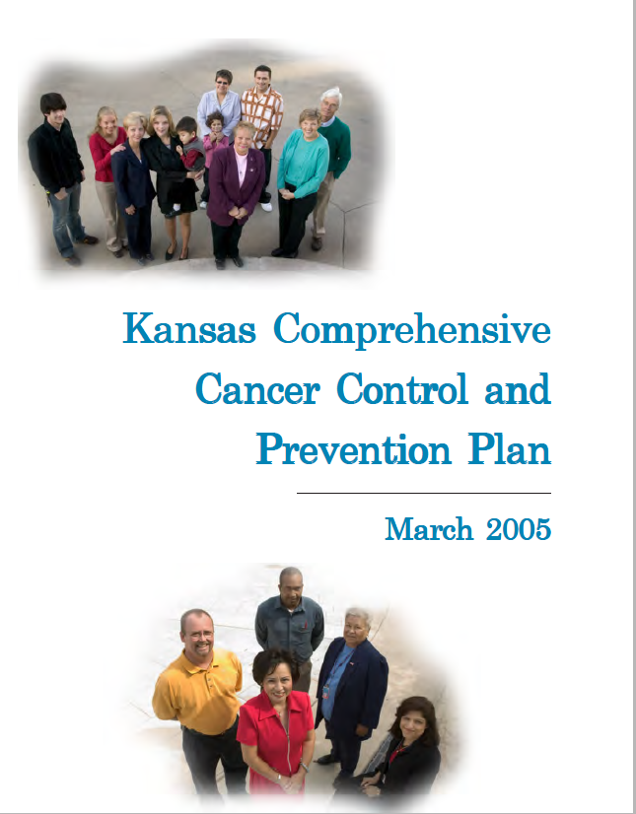


2005
2012-2016
2017-2021
Notes:
State plans over the years

Slide 41
Current Structure
Joshua Mammen, M.D. Coalition Chair
Immunize Kansas Coalition
Health Equity Workgroup
Early Detection and Diagnosis Workgroup
Survivorship Workgroup
Tobacco Free Kansas Coalition
Steering Committee
Coalition Secretary
Policy Committee
North Central Regional Coalition
South Central Regional Coalition
Southeast Regional Coalition
Southwest Regional Coalition
Notes:
Administrative support comes from Kansas Department of Health and Environment, Midwest Cancer Alliance, and Wichita State University-Community Engagement Institute
Coalition Leadership-
Coalition Chair/Co-Chair-we repeat this leadership structure in workgroups and regional coalitions. For the two partner/prevention coalitions, we have a liaison position. The Steering Committee is made up of the coalition chair and co-chair, secretary, prevention coalition liaisons, and the chair and co-chair from all work groups and regional coalitions.
Coalition leadership is elected biennially. The current Chair appoints a Nominating Committee for the Chair and Secretary positions. Officers are selected by a majority vote of the quorum.
How often does your coalition meet? What time of day and where?
Briefly describe how your structure has changed over time, if applicable.

Slide 42
ACCOMPLISHMENTS

Slide 43
KCP Accomplishments
Developed a web-site www.KSCancerPartnership.org
Trained HR professionals on “Survivorship in the Workplace”
Developed an online resource directory for cancer survivors
2016 Tanning bed legislation
Added a cancer survivorship resource directory to www.KSCancerPartnership.org
Developed a catalog of cancer-related patient education materials for providers to order at no cost
Developed HPV videos for public and providers
Received of competitive funding for cancer survivorship objectives (CDC 1501)
2018 Palliative Care Advisory Council legislation
Notes:
8. In 2016, Kansas was awarded funds to address cancer survivorship. KCP members were involved in the following activities.
In person primary care survivorship training for primary care clinic teams
Collection and dissemination of BRFSS data about cancer survivorship in Kansas
Development and delivery of wellness programs for survivors, including programs that continue today. Programs include Cancer Connections virtual education series which features content experts/KCP members, LIVESTRONG at the YMCA, and the Chronic Disease Self-Management Program.

Slide 44
GAPS

Slide 45
KCP Action Plans
Health Equity
Early Detection and Diagnosis
Survivorship
TFKC
IKC
Regional Coalitions
Notes:
Current KCP action plans were developed to address gaps in strategies that haven’t been implemented yet.
Develop and disseminate an exemplary on patient navigation and transportation to cancer treatment in North Central Kansas
Encourage the standardization and regular use of a screening tool for food insecurity among cancer patients
Increase colorectal, breast, and cervical cancer screening within the worksite sector
Increase colorectal, breast, and cervical cancer screening at the clinic level
Increase participation in survivor wellness programs available in the state by cross-promotion and referral among KCP member organizations
Promote availability of free FIT testing in NC Kansas
Coordinate events and classes for lung cancer awareness and tobacco cessation

Slide 46
Next steps & required resources

Slide 47
2017-2021 State Plan Implementation
Resources Needed
2022-? State Plan Development
Notes:
State plans over the years

Slide 48
Questions?
Holly Frye
Cancer Program Manager
Bureau of Health Promotion
Kansas Department of Health and Environment
785-296-8126
holly.frye@ks.gov

Slide 49
Policy Update
Jordan Feuerborn
Peggy Johnson
Notes:
Notes to presenter:
Description of what you learned in your own words on one side.
Include information about the topic
Details about the topic will also be helpful here.
Tell the story of your learning experience. Just like a story there should always be a beginning, middle and an end.
On the other side, you can add a graphic that provides evidence of what you learned.
Feel free to use more than one slide to reflect upon your process. It also helps to add some video of your process.

Slide 50
How to Report KCP Achievements
Ahmed Ismail, MB, BCh, PhD
Notes:
Notes to presenter:
Description of what you learned in your own words on one side.
Include information about the topic
Details about the topic will also be helpful here.
Tell the story of your learning experience. Just like a story there should always be a beginning, middle and an end.
On the other side, you can add a graphic that provides evidence of what you learned.
Feel free to use more than one slide to reflect upon your process. It also helps to add some video of your process.

Slide 51

Cancer Control and Prevention:
from Planning to Evaluation
Ahmed Ismail, MB BCh, PhD
Advanced Epidemiologist
Bureau of Epidemiology and Public Health Informatics
Kansas Department of Health & Environment

Slide 52
Learning Objectives
Identify the components and results of community assessment
Identify the process and sources to quantify the health issues
Be able to develop a sound issue statement
Identify the sources of evidence based practices
Understand the process of prioritizing program and policy options
Identify the steps in program planning

Slide 53
Factors Influencing Decision Making in Public Health
Best available research evidence
Environment
& organizational context
Decision-making
Population characteristics, needs, values, & preferences
Resources, including practitioner expertise
Brownson R, Fielding J, Maylahn C. Evidence-based public health: a fundamental concept for public health practice. Annu Rev Public Health. 2009;30:175– 201.
Notes:
Multiple factors influence decision making in public health, as illustrated on this slide. These include the best available research evidences. Which of these evidences would work with our population of interest? Are there available resources to implement these EBP? What about the environmental and organizational context?

Slide 54
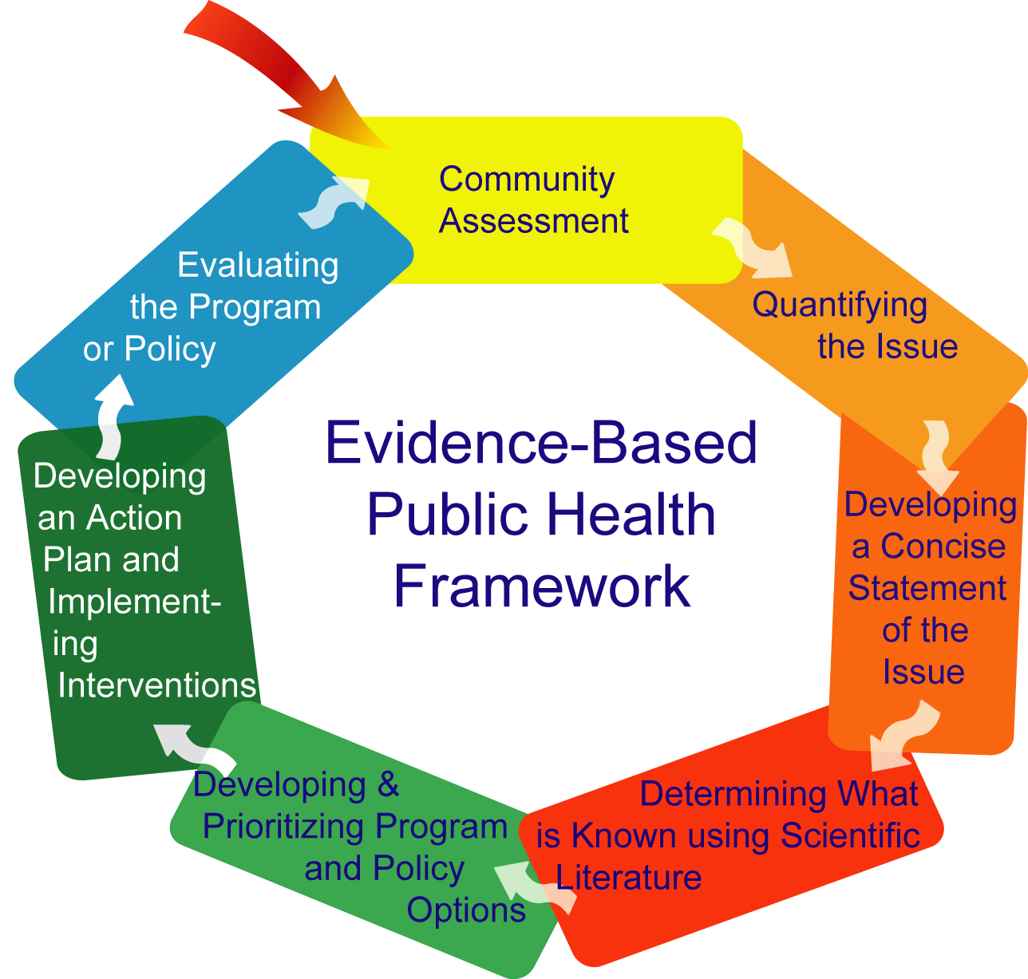
Evidence-Based Public Health Framework
Brownson R, Fielding J, Maylahn C. Evidence-based public health: a fundamental concept for public health practice. Annu Rev Public Health. 2009;30:175– 201.
Notes:
This is the framework that the EVPH revolves around. It starts with Assessing the community needs, quantifying the problem, issuing a brief statement, determining the evidence based strategies, prioritizing the policies and options, developing and implementing an action plan, and evaluating the program or policies.

Slide 55
Community Assessment
Notes:
Using a combination of data sources (quantitative and qualitative) will provide a richer assessment. We will get baseline data, evaluation of the available resources, and engage the community in the assessment process.

Slide 56
Model that supports Community Assessment
Socio Ecological Model
Centers for Disease Control and Prevention (CDC), The Social Ecological Model: A Framework for Prevention, http://www.cdc.gov/violenceprevention/overview/social-ecologicalmodel.html (Accessed Jan 2, 2020).
Notes:
Assessing the community covers different circles: the individual, interpersonal, organizational, community, and on the level of the policies.

Slide 57
Quantifying the Issue
Epidemiology
Public Health Surveillance
Notes:
We quantify the issue employing epidemiological methods and the available public health surveillance systems.

Slide 58
Developing a Concise Statement of the Issue
“If you don’t know where you are going, you might wind up at somewhere else”

Slide 59
Issue Statement
Background/Epidemiological Data
  Based on data from KS BRFSS, only 73% of Kansas women aged 50 years and older had a mammogram within the preceding two years.
  Rates of screening have remained constant over the past 6 years and are lowest among uninsured women.
Strategies Being Considered
  Increase funding for mammogram among uninsured women;
  A mass media campaign to promote screening;
  Education of health care providers on how to effectively counsel women for mammogram screening; and
  A peer support program that involves the target audience in the delivery of the intervention

Slide 60
Searching the Literature
The Pathway to Evidence-Based Resources
Evidence-Based Guidelines
Systematic Reviews
Pre-formulated Searches
Best and Model Practices
Other Resources
Public Health Journals
Public Health Databases
Legislation and Policy
Evidence-Based Practice for Public Health: The Pathway to Evidence-Based Resources. https://library.umassmed.edu/ebpph/. Last accessed on 1/23/2020

Slide 61




Evidence-Based Guidelines
Notes:
The CPSTF was established by the U.S. Department of Health and Human Services (DHHS) in 1996 to develop guidance on which community-based health promotion and disease prevention intervention approaches work and which do not work, based on available scientific evidence. The Centers for Disease Control and Prevention (CDC) is the DHHS agency that provides the CPSTF with technical and administrative support.
The Guide to Clinical Preventive Services contains the U.S. Preventive Services Task Force (USPSTF) recommendations on the use of screening, counseling, and other preventive services that are typically delivered in primary care settings. The USPSTF, an independent panel of experts supported by the Agency for Healthcare Research and Quality (AHRQ), makes recommendations based on systematic reviews of the evidence related to the benefits and potential harms of clinical preventive services.

Slide 62
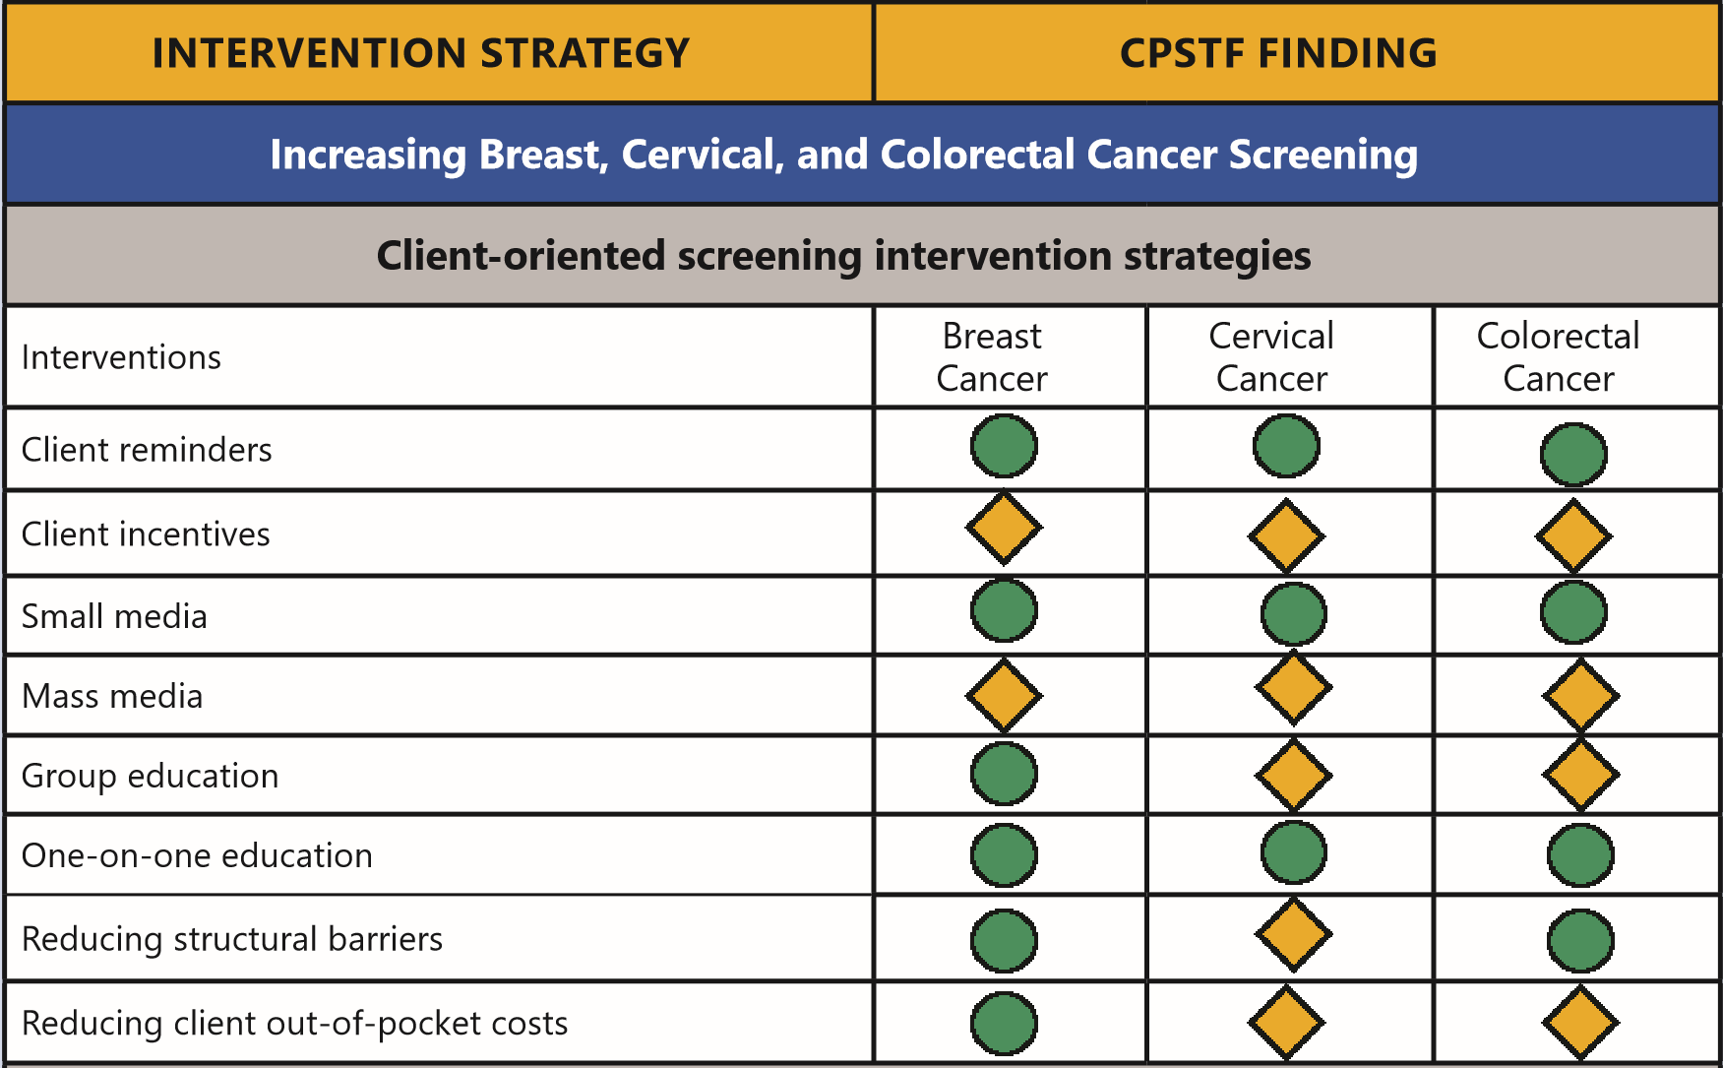
What Works Factsheet – CPSTF Findings on Cancer Screening
Community Preventive Task Force. What Works: Cancer Screening. https://www.thecommunityguide.org/sites/default/files/assets/What-Works-Factsheet-CancerScreening.pdf.

Slide 63

Female Breast Cancer: Screening
Siu, A. L. on behalf of USPSTF (2016). "Screening for Breast Cancer: U.S. Preventive Services Task Force Recommendation Statement." Annals of Internal Medicine 164(4): 279-296.

Slide 64
Developing & Prioritizing Program and Policy Options
√ Measure of burden
  Mortality, morbidity, years of life lost
√ Quantifying Preventability
  Potential effects of intervention
√ Resource
  Cost of intervention, resources needed to carry out a program or policy

Slide 65
Matrix for Prioritizing
More Important Less Important
More Feasible Highest priority Generally low priority
focus
Less Feasible Priority for enhancing No intervention resources

Slide 66
Developing an Action Plan and Implementing Interventions
Good planning can lead to improved implementation
Improved implementation = improved outcomes
√ Clearly linked goals, objectives, and strategies
√ Basis in evidence and assessment
√ Clear roles and responsibilities
√ Clear mechanisms for tracking progress

Slide 67
Action Plan - Example
PRIORITY AREA: Cancer Prevention & Control
FOCUS AREA 3: Increase access to high quality cancer preventative care
GOAL 1.1: Increase female breast cancer screening rate, especially among disparate populations in Kansas.
OBJECTIVE #1: By December 31, 2022, increase the percentage of Kansas women ages 50-75 years who report having a mammogram within the past two years from 73% to 85%.
(Data source: KS Behavioral Risk Factor Surveillance Survey 2018)
STRATIGIES THAT ADDRESS DISPARITY: 1, 2 and 3

Slide 68
Action Plan – Example (Continued)
ACTION PLAN
Evidence Based Strategy | Activities | Lead Partners | Timeframe | Evaluation Measure | Outcome: Product/Result
(1) Remove structural barriers to cancer screening by working with employers to provide employees with paid leave or the option to use flex time for cancer screenings | Work with the Chamber of Commerce’s Health Means Business Committee to connect to worksites to establish paid leave policies for screenings | Staff Time: Kansas Department of Health & Environment (KDHE), Chamber of Commerce, Kansas Healthcare Collaborative (KHC) | January 2020 - December 2022 | Number and type of worksites that adopt practices and policies that reduce structural barriers to cancer screening Number of employees that have worksites with policies for flex time or paid time off for cancer screenings | Increased number of people able to receive cancer screenings
 | Recruit worksites with current policies in development to host one-time on-site screening events
(2)
(3)

Slide 69
Action Plan – Example (Continued)
PERFORMANCE MEASURES
Short Term Process Indicators | Baseline | Source | Frequency
By October 2020, create the infrastructure for a shared calendar for the collaborative to share events for Breast Cancer Awareness Month. | N/A | N/A | One-time
PERFORMANCE MEASURES
Long Term Outcome Indicators | Baseline | KDHE Goal | Source | Frequency
By December 2022, increase the percentage of women ages 50-74 receiving breast cancer screening from 73% (2018) to 85%. | 73% (2018) | 85% | KS Behavioral Risk Factor Surveillance Survey | Every two years

Slide 70
Evaluation – Logic Model – Upcoming !!
Long-term Outcomes/Impacts
Inputs
Activities
Outputs
Short-term Outcomes
Intermediate Outcomes
What the program needs…
What the program does…
Who or what will change because of the program…
Context and Assumptions
External factors that influence getting to outcomes

Slide 71
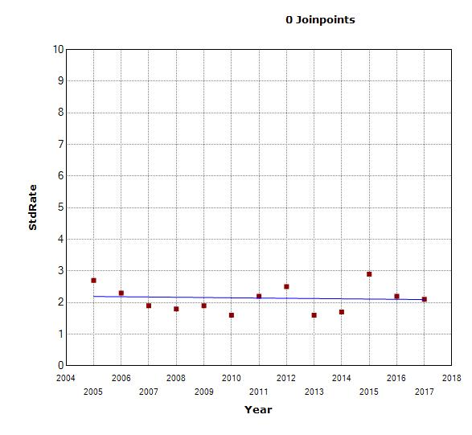
Thank You
Ahmed Ismail, MB BCh, PhD
Advanced Epidemiologist
Bureau of Epidemiology and Public Health Informatics
Kansas Department of Health and Environment
Ahmed.ismail@ks.gov
785-296-1917

Slide 72
Action Plan – KCP Survivorship Workgroup
PRIORITY OBJECTIVE CHOSEN TO WORK ON:
Objective 18: Quality of Life: Adults aged 18 years and older who have ever been diagnosed with cancer who report that poor physical or mental health kept them from doing usual activities, such as self-care, work, or recreation, on 14 or more of the past 30 days.
EVIDENCE BASED STRATEGY CHOSEN TO WORK ON:
Strategy 2: Develop and support a user-friendly web page with resources to inform cancer survivors about physical activity, nutrition and the Kansas Tobacco Quitline for promotion through cancer centers and websites.

Slide 73
Action Plan – KCP Survivorship Workgroup (Continued)
Description of each major task needed to implement the strategy | Group member(s) that will lead the task | Timeline | Information or resources needed | Evaluation Measure | Progress Log
Create a list of evidence-based tobacco, physical activity, and nutrition programs accessible to cancer survivors in Kansas | Holly with group input | January 1, 2020 | Programs used by workgroup members | # of evidence-based tobacco, physical activity, and nutrition programs accessible to cancer survivors in Kansas | 5
Track which workgroup member organizations are promoting which programs and how | Group/Danielle (WSU-CEI)-will be noted during our conference calls | Ongoing | Action Plan Notetaker | # of workgroup member organizations that promoted a program not coordinated by them | 3
Track participation in programs the group has selected to promote | Holly for some programs, group members for other programs | 2x per year-January and July | Program contacts for compiling and sharing the participation reach | # of Cancer Connections participants # of Prostate Network support group participants # of LIVESTRONG at the YMCA participants # of Pink Platoon participants # of Black for Pink participants | 125 125 125 125
Notes:
The table shows that there is a disparity in breast cancer screening rates among women living in rural counties as well as among uninsured, less educated, and lower income women.

Slide 74
Action Plan – EDW NE Workgroup
PRIORITY OBJECTIVE CHOSEN TO WORK ON:
Objective 10A: Prevention: Tobacco: Adults – Reduce the percentage of adults who use cigarettes, e-cigarettes and any tobacco products.
EVIDENCE BASED STRATEGY CHOSEN TO WORK ON:
Strategy 10A: 3 – Work with partners to place advertisements to encourage lung cancer screening and promote Kansas Tobacco Quitline at locations where tobacco is sold

Slide 75
Action Plan – EDW NE Workgroup (Continued)
Description of each major task needed to implement the strategy | Group member (s) that will lead the task | Timeline | Information or resources needed | Evaluation Measure | Progress Log
Host ‘Shine A Light on Lung Cancer’ event in November with speaker/vendors that promote lung cancer screening, KS Quitline, Radon, smoking cessation, lung health, etc. | Daniel Craig will be main point person | November event | Previous vendor list to invite back | # of speakers or vendors that promoted lung cancer screening, KS Quitline, Radon, smoking cessation, lung health, etc. | 5
Secure funding for sponsorship of ‘Shine A Light’ event for expenses. | Morea Charvat Daniel Craig | September October | Previously Waddell & Reed has funded | Total $ raised | 750
Tammy Walker Cancer Center to offer Smoking Cessation Classes. | Daniel Craig - TWCC | On-going | Partnership with MCA | # of Smoking Cessation Classes offered at TWCC # participants | 1 11
Partner with Saline County Health Department to identify strategies to address pregnancy & smoking | Nichole Bruggman-SCHD | On-going | Review best practices | # of strategies identified to address pregnancy & smoking # of strategies implemented | 2 1

Slide 76
Action Plan – EDW NE Workgroup (Continued)
In order be successful in implementing this strategy – identify who (both organizations & individuals) you could recruit to help with your efforts
Name of Organization / Individual | Action Team Member that Will Recruit this Person/Organization
American Cancer Society | Linda Hinnenkamp
Agencies Serving pregnant women-Pregnancy Service Center, Salina Family Healthcare, Salina Regional Health Center, Saline County Health Department | Nichole Bruggman-SCHD

Slide 77
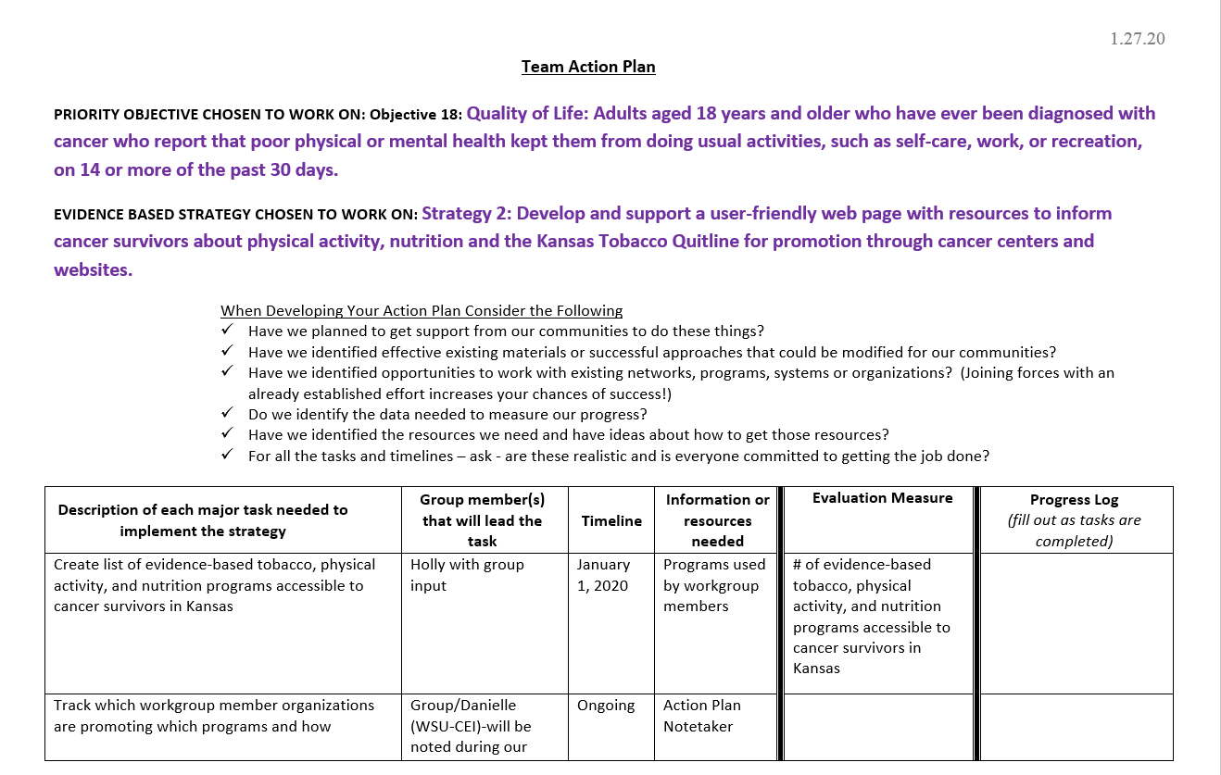

Slide 78
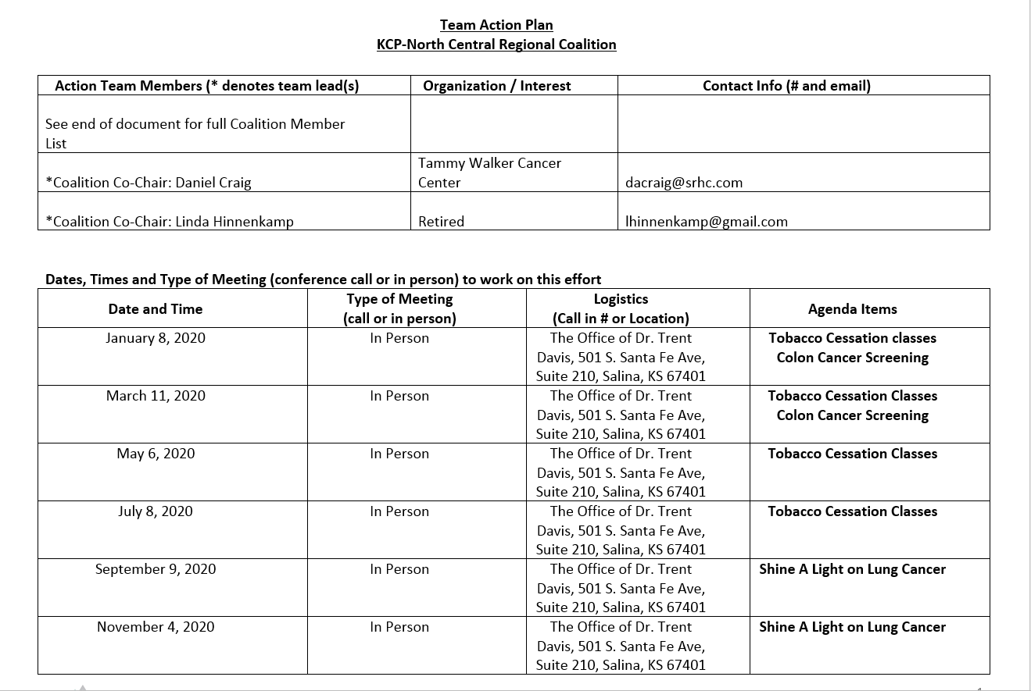

Slide 79
Finalize Workgroup Action Plans
Josh Mammen
Notes:
Notes to presenter:
Description of what you learned in your own words on one side.
Include information about the topic
Details about the topic will also be helpful here.
Tell the story of your learning experience. Just like a story there should always be a beginning, middle and an end.
On the other side, you can add a graphic that provides evidence of what you learned.
Feel free to use more than one slide to reflect upon your process. It also helps to add some video of your process.

Slide 80
Action Plan Report Out
Josh Mammen
Notes:
Notes to presenter:
Description of what you learned in your own words on one side.
Include information about the topic
Details about the topic will also be helpful here.
Tell the story of your learning experience. Just like a story there should always be a beginning, middle and an end.
On the other side, you can add a graphic that provides evidence of what you learned.
Feel free to use more than one slide to reflect upon your process. It also helps to add some video of your process.

Slide 81

Adjourn
Safe Travels!

